Slide 1


Broaden your Vision

Slide 2

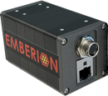
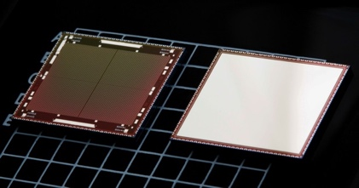




Emberion in brief
From leading edge research to disruptive products
– in brief
Disruptive products
Established in 2016 as a spin-off from Nokia with a highly experienced team
Provides game-changing solutions for professional imaging and detection
Presence in Finland (Espoo) and the UK (Cambridge) with both locations having R&D and production
  Espoo, Finland: camera electronics & image sensors
  Cambridge, UK: photosensitive nanomaterials
Team of 35 highly skilled professionals with world-class research and venture building background
  Motivated personnel with great retention
Unique skills in combining graphene, nanostructured optical absorbers and state-of-the-art custom ROIC⁽¹⁾ design & circuitry
Emberion VIS-SWIR Camera
Emberion Image Sensor
First-in-class SWIR VGA camera with extended wavelength range
High-performance VGA image sensor
Note: 1) ROIC = Read out integrated circuit.
Established in 2016
35 employees
2 locations (Finland & UK)
Founder member of the EU FET Graphene Flagship project

Slide 3
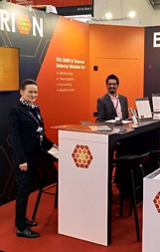
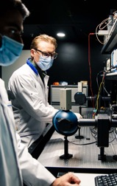
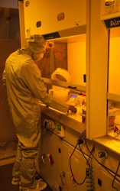
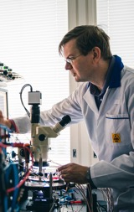
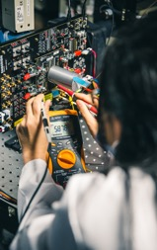
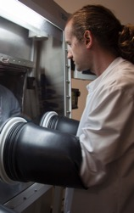
Versatile expertise in deep technology
Multidisciplinary team solving major global challenges
Global approach
Player in the global technology industry – serving customers globally, working with leading edge partners to solve significant industrial problems
Photonics
Characterisation and calibration of optical sensors, image sensor and cameras: sensor performance and image quality
Nanomaterials
Chemistry and physics of nanocrystalline semiconductors and 2D nanomaterials from laboratory to scalable manufacturing
Integrated circuits
Optimized readout circuitry designed for nanomaterial image sensors: high-speed, low-power, low-noise ROIC⁽¹⁾ solutions
Camera systems
Complete vis-SWIR cameras, based on Emberion’s image sensors, ROICs⁽¹⁾, electronics, mechanics, firmware & PC software
Lean manufacturing
Scalable proprietary manufacturing process giving a control point through deep in-house know-how and proven operating procedures
Note: 1) ROIC = Read out integrated circuit (e.g. processes and shapes image signal).

Slide 4

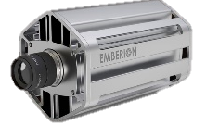
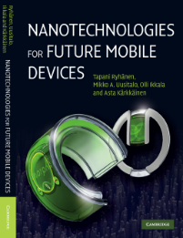

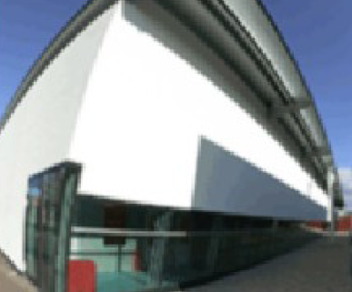
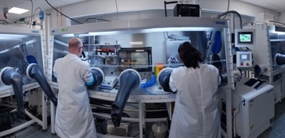
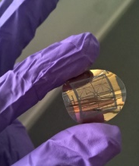
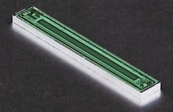

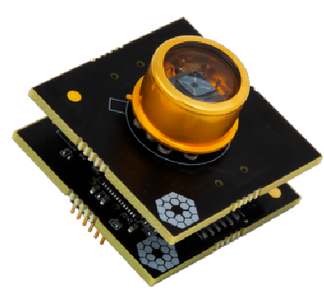


From leading edge research to disruptive innovations
Timeline of significant innovations in the company’s history
Spin-off from Nokia
co-founded by employees and Verso Capital¹⁾
Sales begin for Emberion VS20 VGA industrial camera
Low volume manufacturing capabilities in Cambridge and Espoo established
Establishment of Nokia Research in Cambridge, UK
(collaboration with University of Cambridge)
Team’s vision on nanotechnologies and their impact on electronics and photonics products published
High-speed, SWIR industrial camera:
400 fps
400-2,000 nm spectral range
120 dB DR
Based on Emberion’s modular ROIC
VGA resolution
First graphene electronics project with Aalto University
512-pixel linear array image sensor
Sensor systems business incubation program at Nokia; Initial focus on photodetector arrays on flexible structures for medical sensors and X-ray imaging
Team in a leading role in establishing EU FET GF project (the largest EU research project)
Morph concept published in MOMA, NY
Low-noise
vis-SWIR photodetector
2006
2007
2008
2009
2010
2011
2012
2013
2014
2015
2016
2017
2018
2019
2020
2021
2022
2023
Research laboratory of Nokia
Nokia business
incubation
Independent company
1) Formerly Verso Ventures
Notes:
after 2021 is described in our roadmap slides

Slide 5

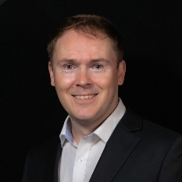
























Introduction to management
Emberion leadership team represents cutting-edge technology R&D with strong business acumen
Tapani Ryhänen
CEO
Mark Allen
CTO
Jose Lopez
Sales Director
Jyri Hämäläinen
Marketing Director
Teppo Malmivaara
Finance Director
Piers Andrew
Research Director
Salla Kalaja
Quality Director
Sami Kyllönen
Production Director
Physicist with 25+ years of experience in R&D leadership
100+ patents granted
Broad network, deep expertise in micro & nanotechnologies
20+ years of technical experience in printed electronics, static field theory, nanomaterials, sensor technologies and the management of technical project teams
25+ years of experience in technology sales & marketing covering photonics, security, machine vision and industrial automation
20+ years in management, business development, technology sales and strategy
20+ years of financial and operational leadership experience in global tech and manufacturing
Previously held global finance leadership positions
Optical physicist with 20 years of experience in photonics, plasmonics and materials science
100+ patents granted
15+ years of experience in business planning, reporting, quality management, organisational development and R&D portfolio management
15+ years of experience in operations, program management and design engineering
Leadership responsibility in organisations with 500+ employees in electronics and medical sectors

Slide 6



Emberion investment round December 2021
Emberion raised €6 million in funding from Nidoco AB, Tesi (Finnish Industry Investment Ltd) and Verso Capital in December 2021
Previous investments by Verso Capital that invested in Emberion since company established in 2016

Slide 7
Emberion Production Flow
Semi-fabless operation: We utilize subcontractors for various established manufacturing steps but keep all the performance critical steps in house
Emberion manages the whole manufacturing process through its captive know-how and IPR and concentrates own resources on the new value adding processes
Overall system design by Emberion
Camera
firmware and algorithms
Own design
& intellectual property
Standard
CMOS + post-processing
Fabrication of photodiode layers on CMOS wafers
Image sensor
packaging
Camera
assembly and programming
Camera testing and calibration
Synthesis of quantum dots
Sensor package components
Camera core mechanics and electronics
Emberion
Subcontracting

Slide 8
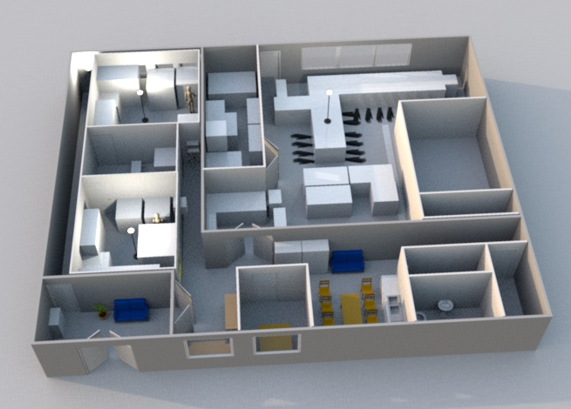
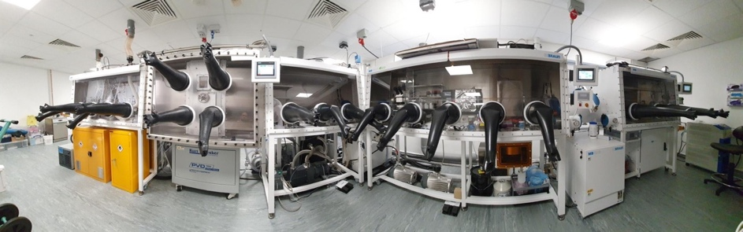
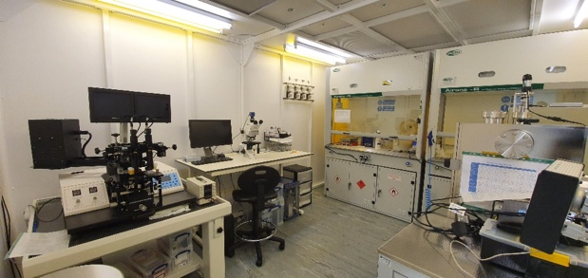
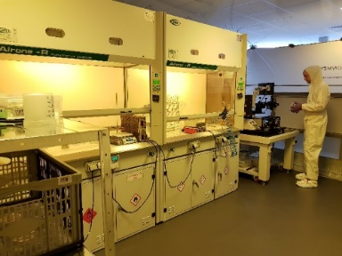
Cambridge Site Capabilities
Fab facility
State of the Art glovebox system
Darkroom / measurement lab
Clean working environment
Capabilities for small volume production; a few 8” wafers per week

